Slide 1
"Predictive Maintenance and Condition-Based Monitoring (CBM) for Maritime Drive Systems Using Machine Learning Techniques"
Domain-Maintenance
Divya. N

Slide 2

Points Of Discussion:
Problem Statement
Objective of the Project
Understanding Dataset
Data Preprocessing
Exploratory Data Analysis
Data Transformation
ML Model Performance
Conclusion

Slide 3
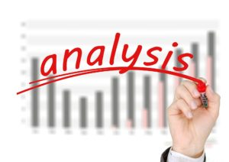
Problem Statement :
This dataset records operational performance metrics of a ship's gas turbine propulsion system. Each row represents a set of measurements taken under specific conditions, likely at different times or operational states. The parameters captured include various torque measurements, rates of revolutions, temperatures, pressures, fuel flow, and state coefficients. These metrics are crucial for monitoring and analyzing the propulsion system's performance, efficiency, and maintenance needs.
The data can be used for predictive maintenance, performance optimization, and anomaly detection. By analyzing the relationship between these parameters, one can identify patterns that indicate potential issues or areas for improvement in the propulsion system.

Slide 4
Objective:
The main objective is to enhance the reliability, efficiency, and safety of maritime drive systems through the application of machine learning techniques. Specifically, the goals are as follows:
Predict equipment failures before they occur.
Determine the optimal times for maintenance activities based on the condition and performance data.
Identify unusual patterns or deviations from normal operational behavior.
Analyze operational data to identify parameters that significantly impact performance and efficiency.
Minimize maintenance costs and operational expenses.
Enhance the safety of the maritime operations by ensuring the propulsion system operates within safe parameters.
Utilize data analytics to support maintenance and operational decisions.

Slide 5
Understanding The Data:
Data Description:
Lever position(measure in RPM-Low to High): Position of the ship's lever (range: 1.138 to 9.3).(Indicates throttle speed
Ship speed (v): Speed of the ship, likely in knots (range: 3 to 27).
Gas Turbine (GT) shaft torque (GTT): Torque on the gas turbine shaft in kN m (range: 289.964 to 72763.329).
GT rate of revolutions (GTn): Revolutions per minute (rpm) of the gas turbine (range: 1349.489 to 3560.395).
Gas Generator rate of revolutions (GGn): Revolutions per minute (rpm) of the gas generator (range: 6677.38 to 9778.528).
Starboard Propeller Torque (Ts): Torque on the starboard propeller in kN (range: 7.584 to 644.905).
Port Propeller Torque (Tp): Torque on the port propeller in kN (range: 7.584 to 644.905).
High Pressure (HP) Turbine exit temperature (T48): Temperature at the exit of the high-pressure turbine in Celsius (range: 464.006 to 115.797).
GT Compressor inlet air temperature (T1): Temperature of inlet air to the gas turbine compressor in Celsius (constant at 288).
GT Compressor outlet air temperature (T2): Temperature of outlet air from the gas turbine compressor in Celsius (range: 550.563 to 789.094).
HP Turbine exit pressure (P48): Pressure at the exit of the high-pressure turbine in bar (range: 1.096 to 4.498).
GT Compressor inlet air pressure (P1): Pressure of inlet air to the gas turbine compressor in bar (constant at 0.998).
GT Compressor outlet air pressure (P2): Pressure of outlet air from the gas turbine compressor in the bar (range: 5.947 to 22.811).
GT exhaust gas pressure (Pexh): Pressure of exhaust gas from the gas turbine in the bar (range: 1.019 to 1.049).
Turbine Injection Control (TIC): Control parameter for turbine injection in percentage (range: 3.879 to 92.556).
Fuel flow (mf): Rate of fuel flow into the gas turbine in kg/s (range: 0.079 to 1.832).
GT Turbine decay state coefficient: Coefficient related to the decay state of the gas turbine turbine (range: 0.975 to 1). (Note- usually a drop of 5-10% in efficiency might be considered critical for gas turbines

Slide 6
Data Pre- Processing :
Data processing requires cleaning of data and preparing it for further analysis. Our cleaning process involve the following parts:
Necessary libraries such as pandas, numpy, matplotlib, and seaborn are imported.
Handling Missing Values: Here I have filled the missing values with ‘ffill’ method
Convert columns to appropriate data types, such as converting object data types to numeric types using pd.to_numeric().
Duplicate rows are identified and removed using df.drop_duplicates().
A correlation matrix is computed to identify relationships between variables.
Various plots such as histograms, pair plots, and heatmaps are created to visualize the data distribution and relationships.
All the values in column ['GT Compressor inlet air temperature (T1) [C]'] & ['GT Compressor inlet air pressure (P1) [bar]'] are same so we dropped both the columns
I renamed all the column names.
I have done outlier treatment using boxplot and there is no outliers in the data set

Slide 7
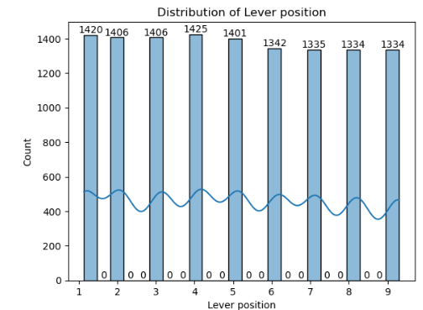
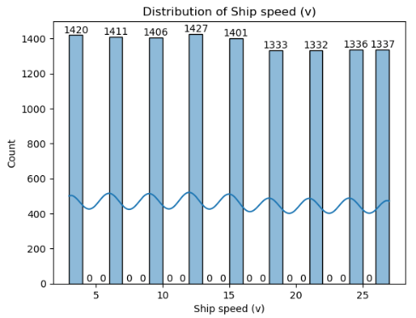
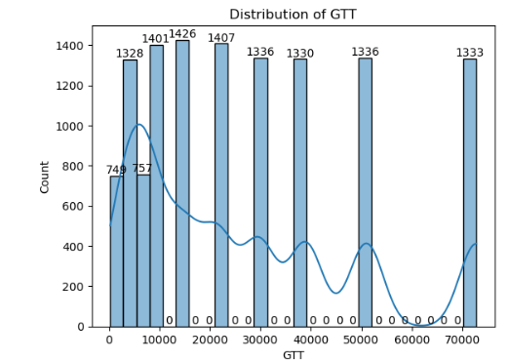
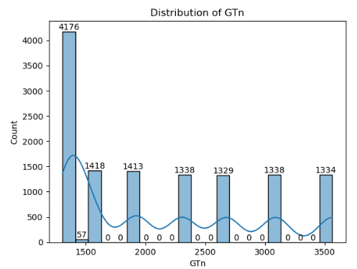
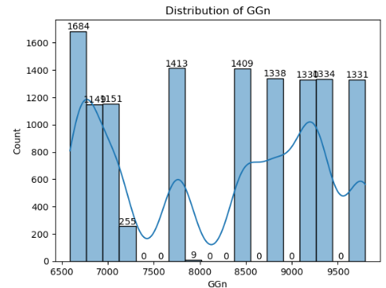
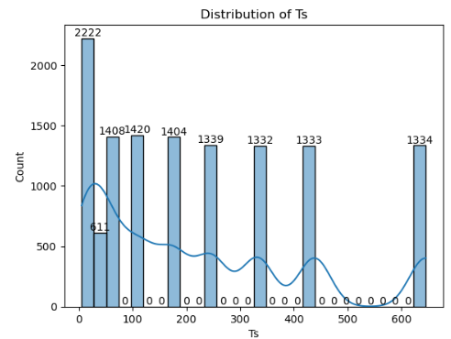
Data Visualization:- (Hist Plot)

Slide 8
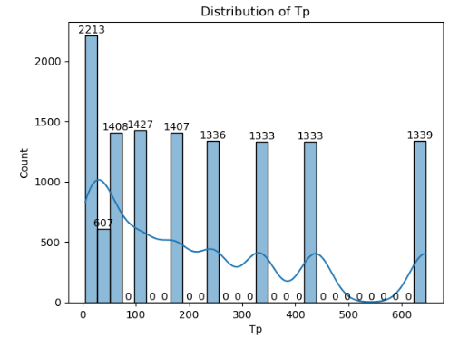
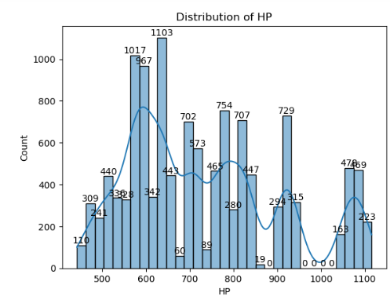
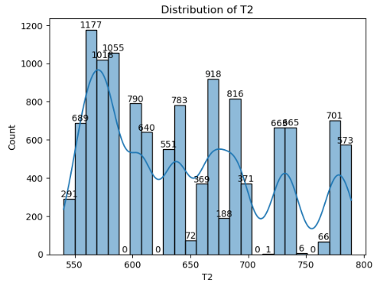
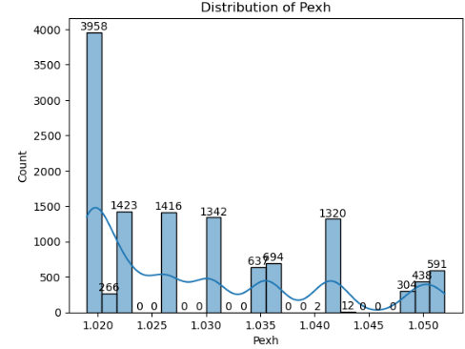
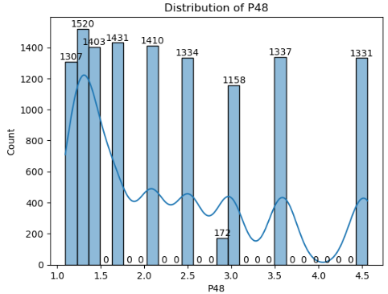
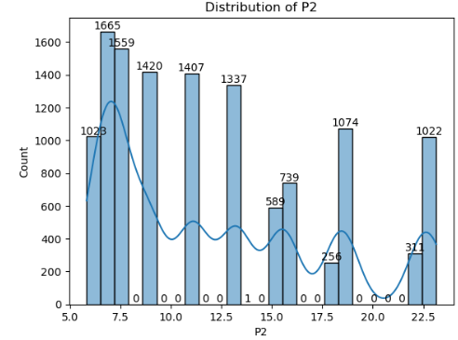
Data Visualization:- (Hist Plot)
Data Visualization:

Slide 9
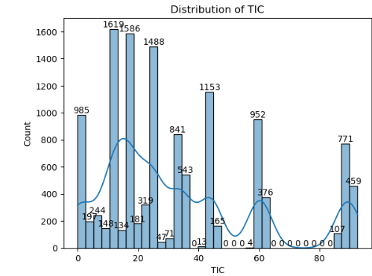
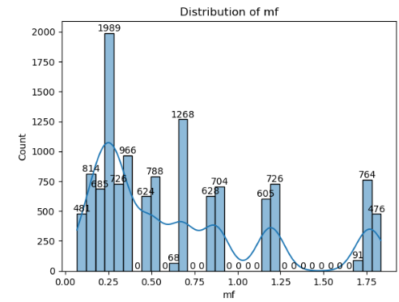
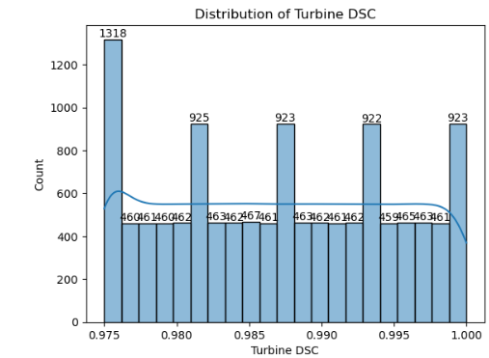
Data Visualization:- (Hist Plot)

Slide 10
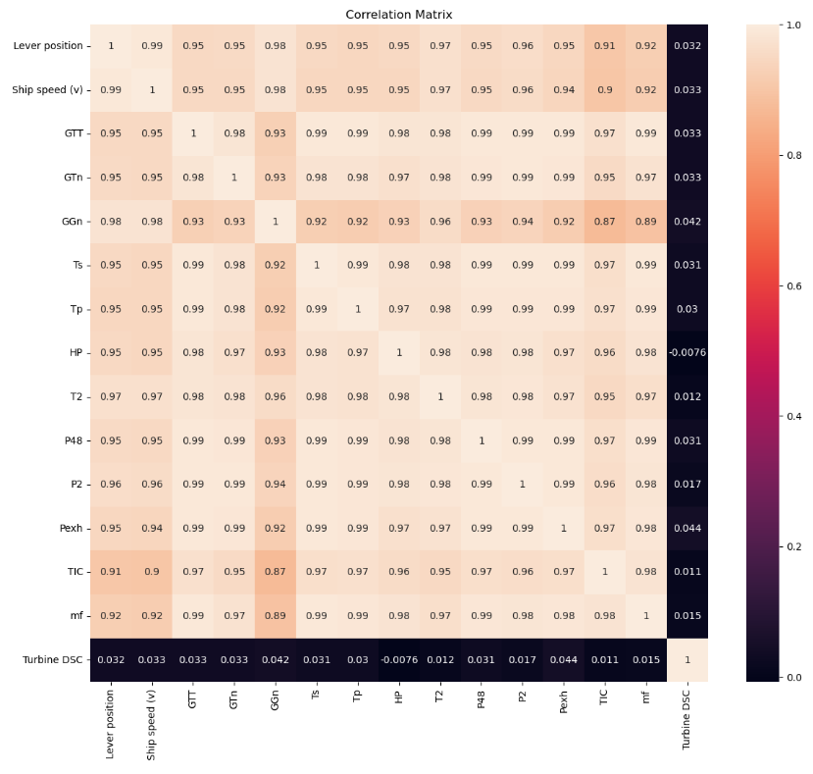
Data Visualization:
Correlation Heatmap:
There exists a very strong positive correlation among all the input features
As we can see most of the input features have a correlation value of 0.97 and above
This means that when an input feature increases by one unit the correlated feature corresponding to that input feature also increases by one unit
These input correlations will be useful in finetuning the base model in the future in the form of interaction terms
Both the output labels have almost no correlation with any of the input features

Slide 11

Data Scaling and Data Splitting:
Data Scaling:
Used StandardScaler from scikit-learn to scale the data.
This scaling method transforms data to have a mean of 0 and a standard deviation of 1.
Train-Test Split:
Chose an 80-20 split for the dataset.
Allocated 80% of the data to the training set to capture enough patterns and relationships for model training.
ML Model Selection:
Implement multiple machine learning algorithms, including linear regression, decision trees, and random forest with regression techniques
Evaluated model performance using metrics such as R-squared score, means square error, and root mean square error

Slide 12
Model Performance:
Comparison of Models: Table for comparing the performance metrics of different models.
S.no | Regressions | MSE(Mean squared error) |  | RMSE(Root mean Squared error) |  | R2(Root Squared)
 |  | Train Score | Test Score | Train Score | Test Score | Train Score | Test Score
1. | Linear Regression | 5.41 | 5.36 | 0.007 | 0.007 | 0.09 | 0.07
2. | Decision Tree Regressor | 1.28 | 3.89 | 0.001 | 0.001 | 0.97 | 0.93
3. | Random Forest Regressor | 8.0 | 2.0 | 0.000 | 0.000 | 0.98 | 0.96
After performing various regression techniques on our predictive model and we found out that Random Forest Regression has performed better than any other regression model with 96%.

Slide 13
Conclusion:
This project demonstrated the power of machine learning in predictive maintenance and performance optimization for maritime drive systems. By systematically analyzing and interpreting operational data, we were able to provide valuable insights and practical recommendations that can lead to significant improvements in the efficiency, reliability, and longevity of the ship's gas turbine propulsion system. Our findings underscore the potential of data-driven approaches in modernizing maintenance strategies and optimizing maritime operations.

Slide 14


